Slide 1
My MHD code
Justin Angus

Slide 2
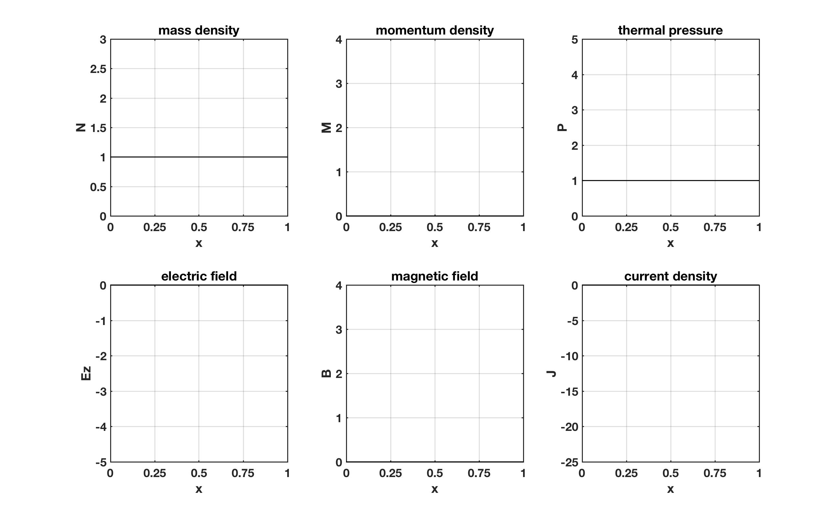
2 Torr D with kJ pulse

Slide 3
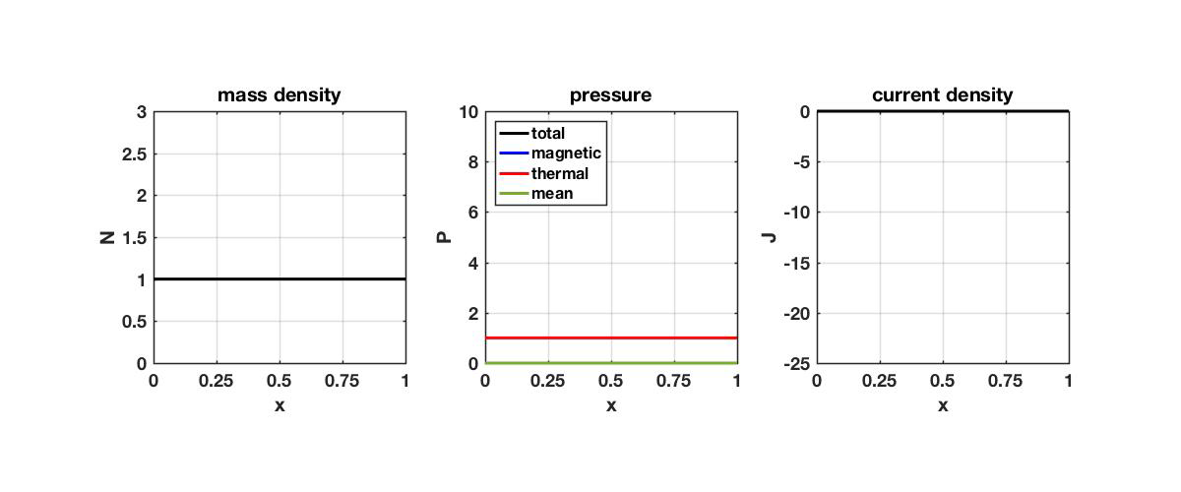
2 Torr D with kJ pulse

